Slide 1


Rahin Mansoor Ali Al-Hammadi
08/22/2023
Notes:
Winning space race with data science

Slide 2

Outline
Executive Summary
Introduction
Methodology
Results
Conclusion
Appendix

Slide 3
Executive Summary
Summary of methodologies
Data collection
Data wrangling
Exploratory data analysis (EDA) with data visualization
EDA with SQL
Building an interactive map with Folium
Building a Dashboard with Plotly Dash
Predictive analysis (Classification)
Summary of all results
EDA results
Interactive analytics
Predictive analysis

Slide 4
Introduction
Project background and context
SpaceX (Space Exploration Technologies Corporation) is a space transportation and aerospace manufacturer founded in 2002 by Elon Musk.
SpaceX has been a disruptive force in the worldwide launch industry as its launch services are less expensive than many of its competitors.
SpaceX charges $62 million for a Falcon 9 rocket launch, much cheaper than competitor startups like the European launcher Arianespace's Ariane 5 or U.S. rocket builder United Launch Alliance’s (ULA) Atlas V, which can cost up to $165 million.
Problems you want to find answers
The aim of this project is predicting if the first stage of the SpaceX Falcon 9 rocket will land successfully based on the data available.

Slide 5

Section 1

Slide 6
Methodology
Executive Summary
Data collection methodology:
Perform data wrangling
Perform exploratory data analysis (EDA) using visualization and SQL
Perform interactive visual analytics using Folium and Plotly Dash
Perform predictive analysis using classification models
Describe how data was collected
Describe how data was processed
How to build, tune, evaluate classification models

Slide 7
Data Collection
The data sets were collected:
Requesting rocket launch data from SpaceX API or from HTML.
Return output will be the SpaceX data in JSON format. We apply the json_normalize function to convert the json result into a dataframe. In Case using webscraping to collect the data we applies BeautifulSoup object from the HTML response.
Filtering the dataframe to include only Falcon 9 launches data.
Data wrangling.
Requesting data from SpaceX API /HTML
Filtering the dataframe to include only Falcon 9 launches data.
Convert the json result into a dataframe/create BeatifulSoup object from HTML
Data wrangling

Slide 8
Data Collection – SpaceX API
Data collection with SpaceX REST:
Requiting response from API
Converting the data from JSON format to a Pandas dataframe using .json_normalize()
Customize the dataframe (removing columns that we are not using, convert the date format, etc.)
Applying custom functions to clean and prepare the data
Combine the clean data (columns) into a dictionary
Filter the dataframe to only include Falcon 9 launches
Data wrangling
Requiting response from API
Converting to a Pandas dataframe
Customize the dataframe
Applying custom functions to clean and prepare the data
Combine the clean data (columns) into a dictionary
Filter the dataframe to only include Falcon 9 launches
Data wrangling
https://github.com/Rahinmans/space-x-project-/blob/main/jupyter-labs-spacex-data-collection-api.ipynb

Slide 9
Data Collection - Scraping
Data collection with web scraping
Request the Falcon9 Launch Wiki page from its URL as HTML
Create a BeautifulSoup object from the HTML response
Extract all column/variable names from the HTML table header
Customize the dataframe (create an empty dictionary with keys from the extracted column names, fill up the launch_dict with launch records extracted from table rows, clean and prepare the data)
Create a data frame by parsing the launch HTML tables
Request the data from HTML
Creating BeautifulSoup Object
Finding tables and getting column names
Customize the dataframe
Converting dictionary to dataframe
https://github.com/Rahinmans/space-x-project-/blob/main/jupyter-labs-webscraping.ipynb

Slide 10
Data Wrangling
Identify the missing values in each attribute
Identify the missing values in each attribute
Dealing with missing values in PayloadMass attribute.
Calculate the number of launches on each site
Calculate the number and occurrence of each orbit
Calculate the number and occurrence of mission outcome per orbit type
Create a landing outcome label from Outcome column
Dealing with missing values
Calculate the number of launches on each site
Calculate the number and occurrence of each orbit
Calculate the number and occurrence of mission outcome per orbit type
Create a landing outcome label from Outcome column
https://github.com/Rahinmans/space-x-project-/blob/main/jupyter-labs-spacex-data_wrangling.ipynb

Slide 11
EDA with SQL
Download and Connect to the database
Display the names of the unique launch sites in the space mission
Display 5 records where launch sites begin with the string 'CCA’
Display the total payload mass carried by boosters launched by NASA (CRS)
Display average payload mass carried by booster version F9 v1.1
List the date when the first successful landing outcome in ground pad was acheived.
List the names of the boosters which have success in drone ship and have payload mass greater than 4000 but less than 6000
List the total number of successful and failure mission outcomes
List the names of the booster_versions which have carried the maximum payload mass. Use a subquery
List the records which will display the month names, failure landing_outcomes in drone ship ,booster versions, launch_site for the months in year 2015.
Rank the count of successful landing_outcomes between the date 04-06-2010 and 20-03-2017 in descending order.
Download and Connect to the database
Display the some data (CCA, CRS) do some colleclation (average)
List and filtering the date (e.g., total number of successful and failure mission outcomes)
Rank the count of successful landing_outcomes
https://github.com/Rahinmans/space-x-project-/blob/main/jupyter-labs-SQL.ipynb

Slide 12
EDA with Data Visualization
Scatter plot
the FlightNumber vs. PayloadMassand overlay the outcome of the launch.
Scatter plot
the relationship between Flight Number and Launch Site
Bar plot
the relationship between Payload and Launch Site
Scatter plot
the relationship between success rate of each orbit type
Scatter plot
the relationship between FlightNumber and Orbit type
Scatter plot
the relationship between Payload and Orbit type
Line plot
the launch success yearly trend
https://github.com/Rahinmans/space-x-project-/blob/main/jupyter-labs-data-VIZ.ipynb
Notes:
- We see that as the flight number increases, the first stage is more likely to land successfully. The payload mass is also important; it seems the more massive the payload, the less likely the first stage will return.

Slide 13
Build an Interactive Map with Folium
Mark all launch msites on a map
Mark the success/failed launches for each site on the map
Calculate the distances between a launch site to its proximities
By adding those markers:
It enable us to find some geographical patterns about launch sites.
It enable us to easily identify which launch sites have relatively high success rates.
https://github.com/Rahinmans/space-x-project-/blob/main/jupyter-lab_launch_site_location-map-Folium.ipynb

Slide 14
Build a Dashboard with Plotly Dash
Add a Launch Site Drop-down Input Component
Add a callback function to render success-pie-chart based on selected site dropdown
Add a Range Slider to Select Payload
Add a callback function to render the success-payload-scatter-chart scatter plot
Add a dropdown list of Launch Sites
Add a callback function to render success-pie-chart
Add a Range Slider to Select Payload
Add a callback function to render the success-payload-scatter-chart
https://github.com/Rahinmans/space-x-project-/blob/main/jupyter-labs-Dashboard.ipynb

Slide 15
Predictive Analysis (Classification)
Load and transform the data
Train_test_split to split data into training and test data.
Create four Machine learning models (Logistic regression, SVM, Decision Tree, KNN), and create GridSearchCV objectives for each models.
Calculate best parameters , accuracy and confusion matrix
Selection of model that performs best which is DecisionTree with a score of 0.90.
Load and transform the data
Split data into training and test data
Create four Machine learning models
Calculate best parameters , accuracy and confusion matrix
Selection of model that performs best
https://github.com/Rahinmans/space-x-project-/blob/main/jupyter-labs-SpaceX_Machine_Learning_Prediction.ipynb
Notes:
Best model is

Slide 16
Results
Exploratory data analysis results
Predictive analysis results
Interactive analytics demo in screenshots

Slide 17

Section 2

Slide 18
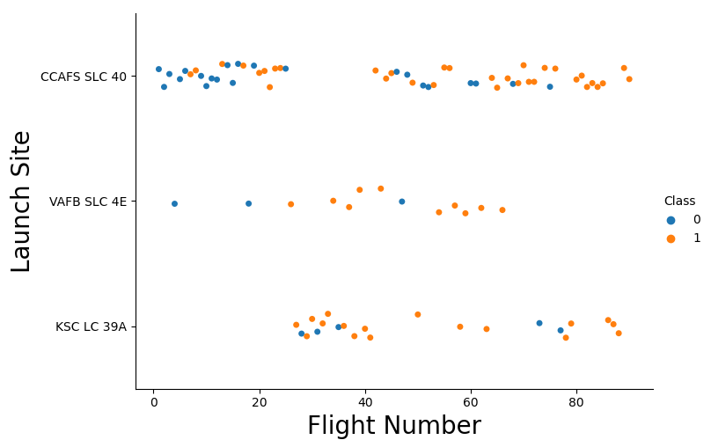
Flight Number vs. Launch Site
With time the successful rate has increased for every Launch Site, particularly for the site “CCAFS SLC 40”, where are concentrated the majority of the launches.
For VAFB SLC 4E and KSC LC 39A has a higher successful rate but represents one third of the total flight launches.

Slide 19
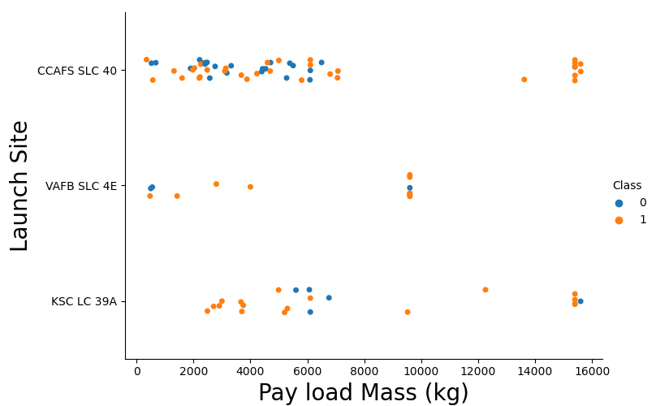
Payload vs. Launch Site
In VAFB SLC 4E launch site there are no rockets launched for heavy payload mass (greater than 10000kg)
In KSC LC 39A launch site there are no rockets launched for lower payload mass (less than 2500kg)
In CCAFS SLC 40 launch site the rockets launched with payload mass less than 7500kg and more than 13000kg, but not in between.

Slide 20
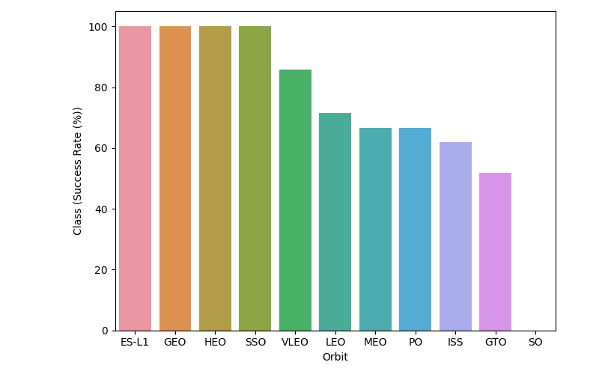
Success Rate vs. Orbit Type
The first 4 orbit types (ES-L1, GEO, HEO, SSO) had the best successful rate.
The bar chart must be interpreted with number of launches per Orbit type.

Slide 21
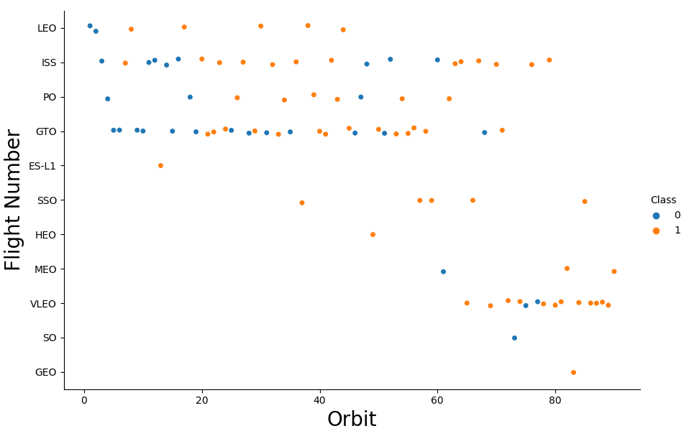
Flight Number vs. Orbit Type
As expected, there are more failures at the beginning of the series of launches, but after the first 40 launches the ratio improves by reducing the 50% of unsuccessful landings.
GTO and ISS orbits has the higher concentration of launches with the lowest ration of successful landings.
The orbits with higher successful rate, has one or just a few number of launches.

Slide 22
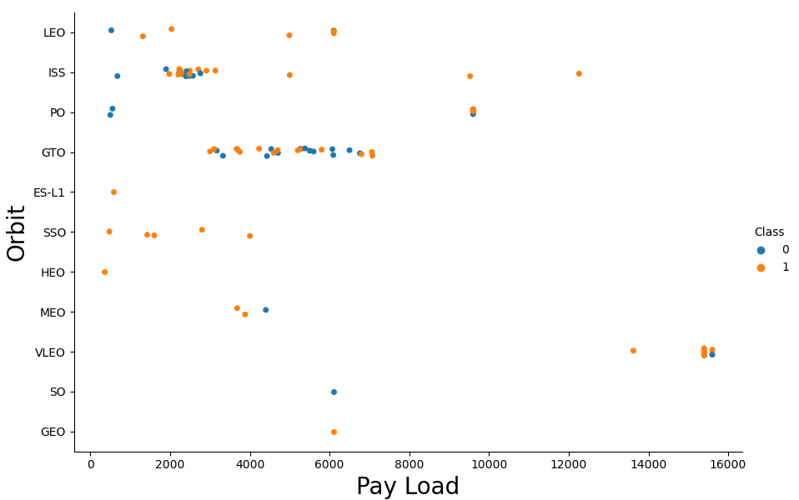
Payload vs. Orbit Type
Exists a visible limit of Payload around 7600kg less than 10 launches exceed that limit.
With heavy payloads the successful landing rate are more for Polar, LEO and ISS.
GTO, it can not find a different between successful or unsuccessful landings as the distribution here is lined and indicated no different in the payload volume.

Slide 23
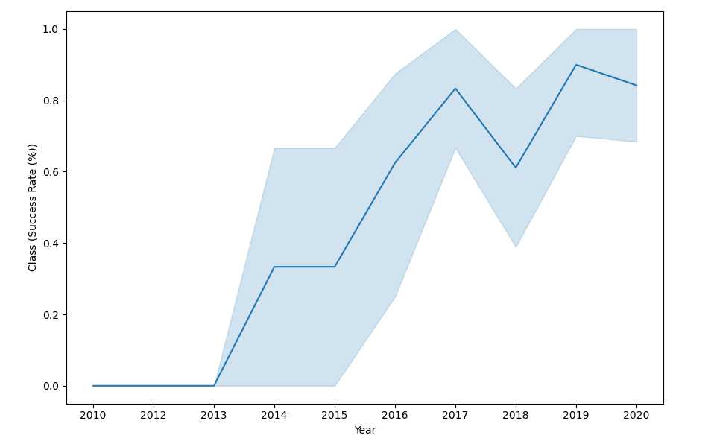
Launch Success Yearly Trend
The success rate of landings could be grouped into two groups:
For the first period (2010-2012) the success rate were very low.
For the second period (2013-2020) the success rate were gradually increased, although there was a slide drop in 2018.

Slide 24
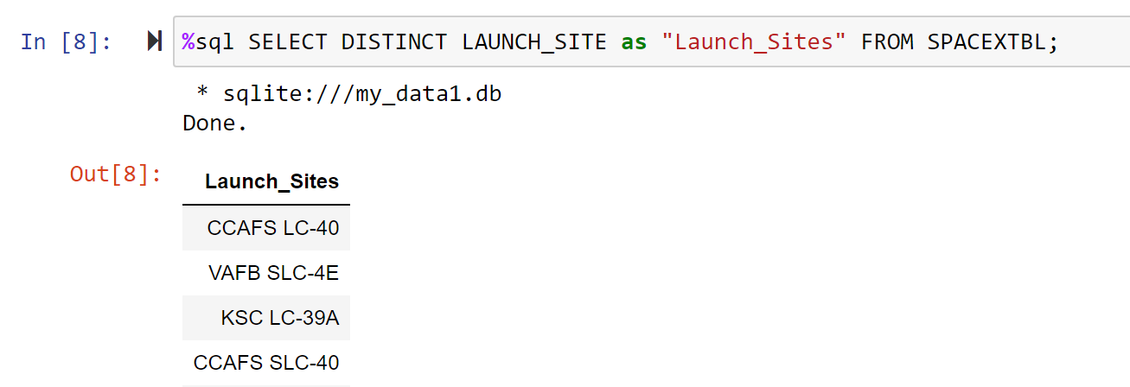
All Launch Site Names
The ‘DISTINCT’ function has been used to find the unique values in the launch site column.
The four unique launch sites in the space mission:
CCAFS LC-40
VAFB SLC-4E
KSC LC-39A
CCAFS SLC-40

Slide 25
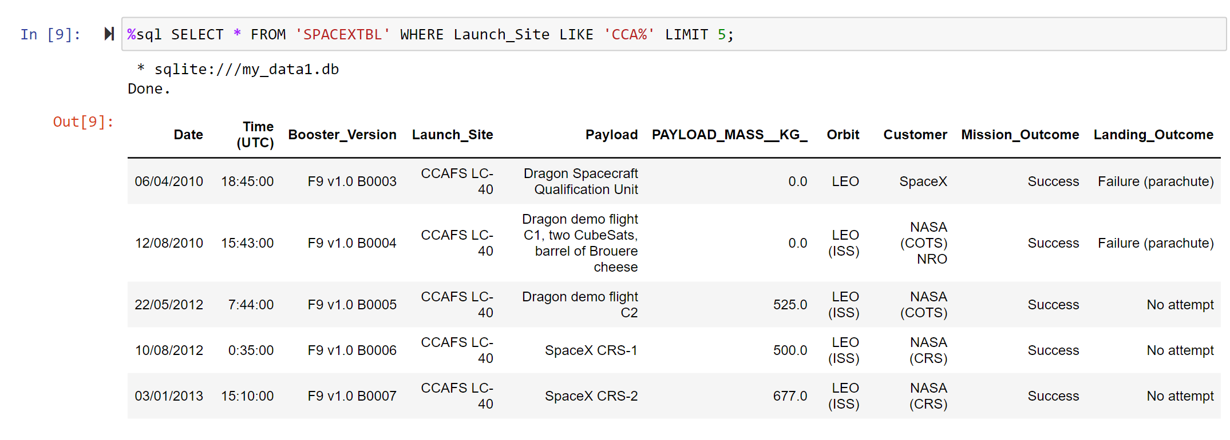
Launch Site Names Begin with 'CCA'
Using the query WHERE, LIKE, and LIMIT to get 5 records where launch sites begin with `CCA`

Slide 26
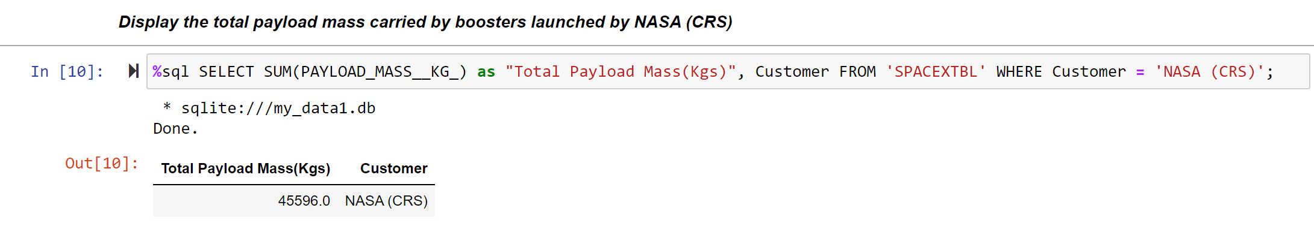
Total Payload Mass
Using SUM function and WHERE clause to calculate the total payload carried by boosters from NASA

Slide 27
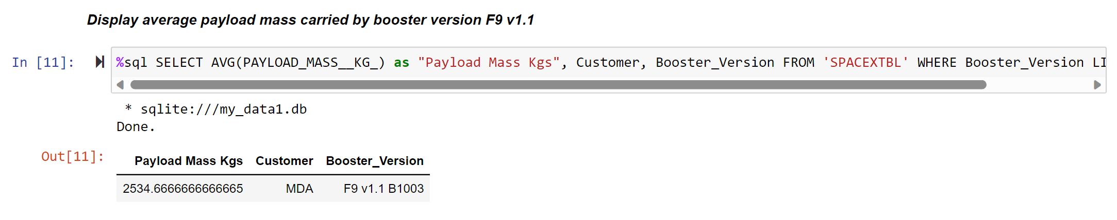
Average Payload Mass by F9 v1.1
Using AVG() function and WHERE clause to calculate the average payload mass carried by booster version F9 v1.1

Slide 28
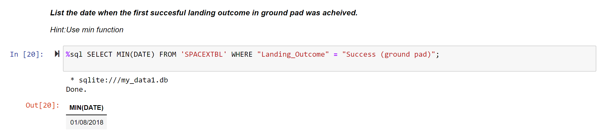
First Successful Ground Landing Date
Using MIN function and WHERE clause to find the dates of the first successful landing outcome on ground pad

Slide 29
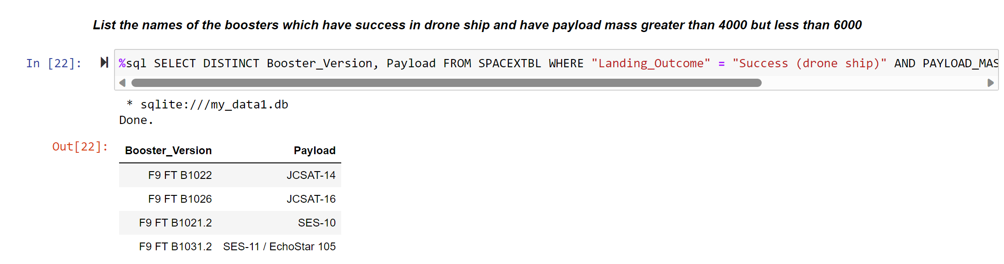
Successful Drone Ship Landing with Payload between 4000 and 6000
Using the WHERE clause and AND operator to list the names of boosters which have successfully landed on drone ship and had payload mass greater than 4000 but less than 6000.

Slide 30
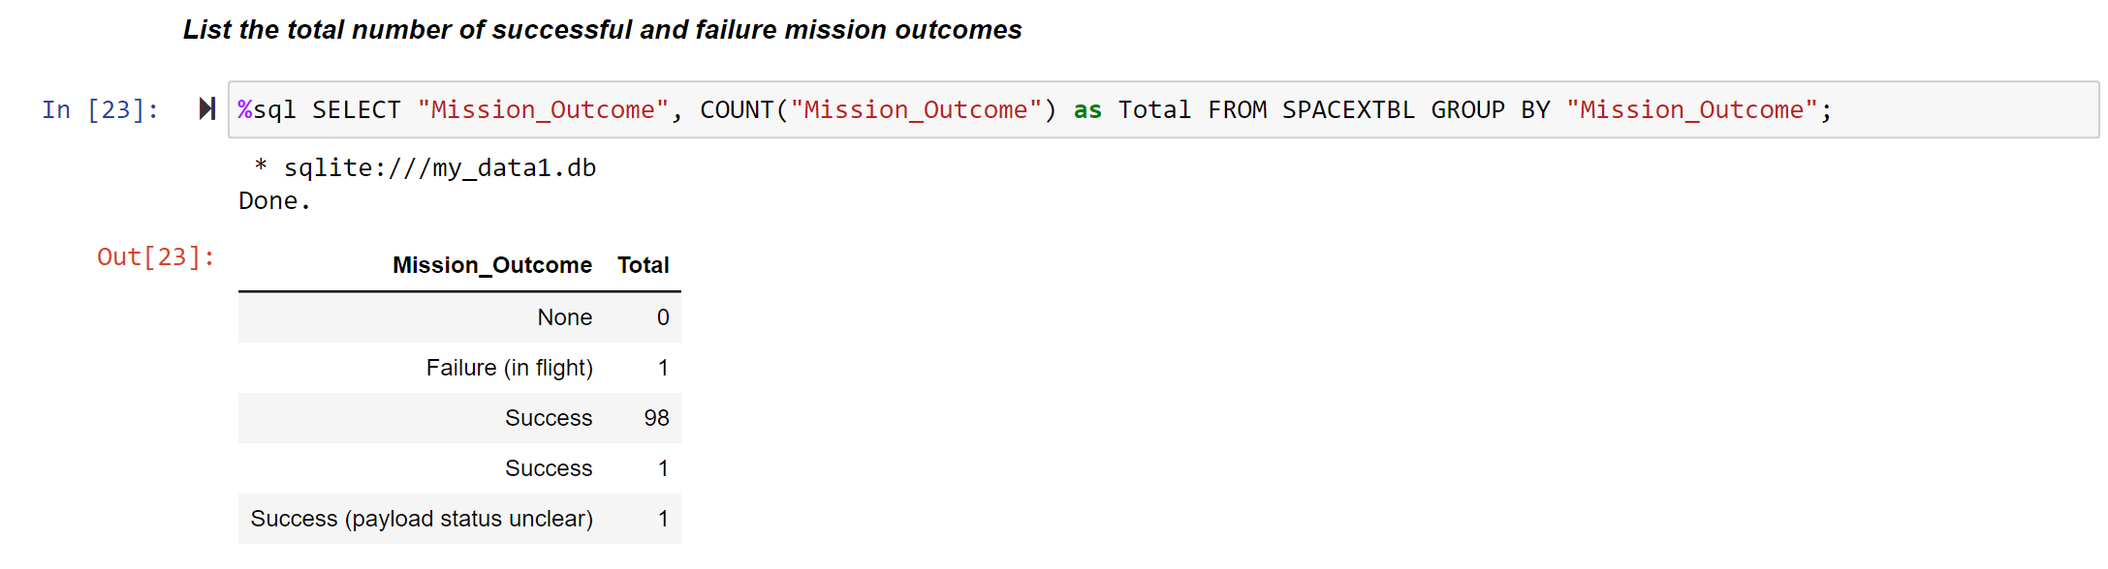
Total Number of Successful and Failure Mission Outcomes
Using COUNT function with GROUP BY statement to calculate the total number of successful and failure mission outcomes.

Slide 31
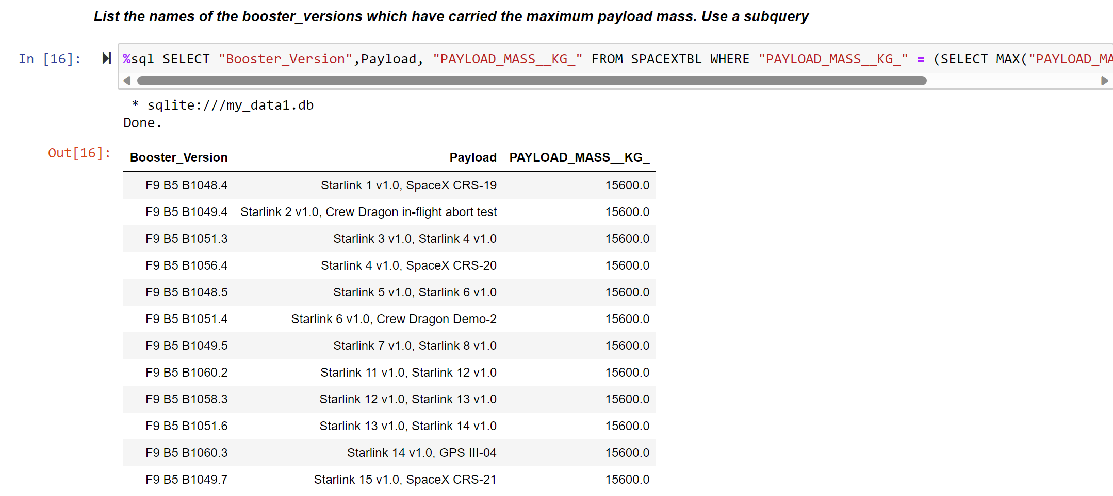
Boosters Carried Maximum Payload
Using subquery to find list the names of the booster which have carried the maximum payload mass

Slide 32
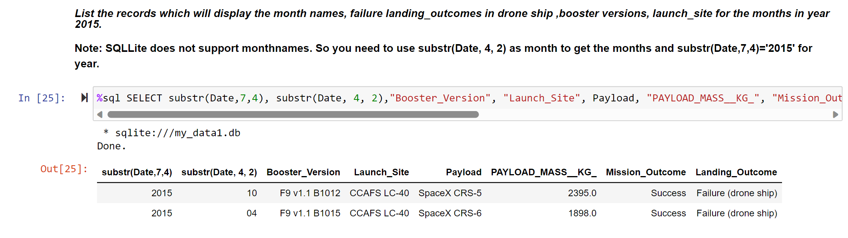
2015 Launch Records
Using WHERE clause, LIKE to list the failed landing_outcomes in drone ship, their booster versions, and launch site names for in year 2015

Slide 33
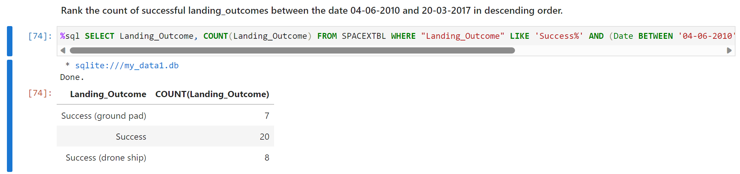
Rank Landing Outcomes Between 2010-06-04 and 2017-03-20
Using COUNT function, WHERE clause BETWEEN operator and GROUP BY statement to rank the count of successful landing outcomes between the date 2010-06-04 and 2017-03-20, in descending order.

Slide 34

Section 3

Slide 35
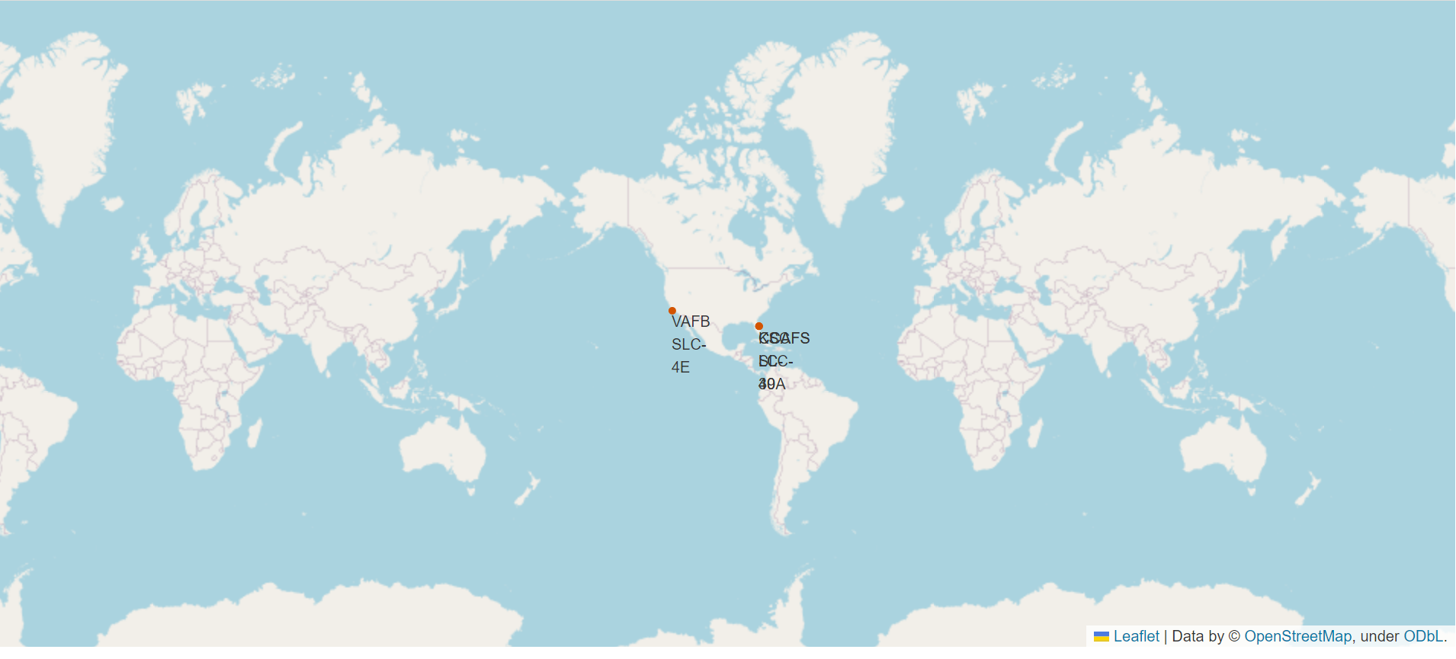
All launch sites markers based on Global map
The SpaceX launch sites are in the USA (Florida and California).

Slide 36
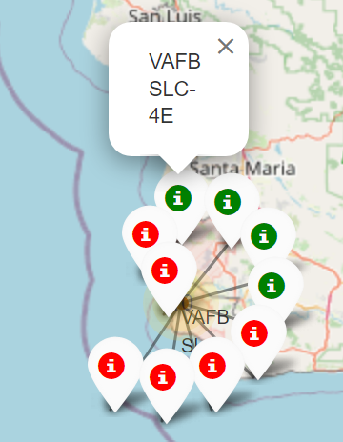
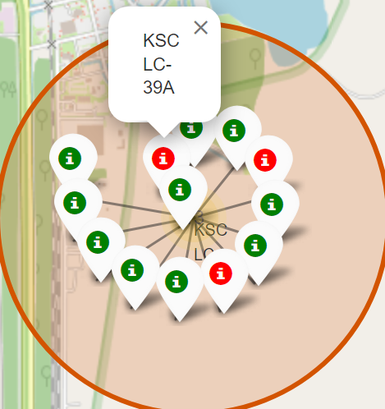
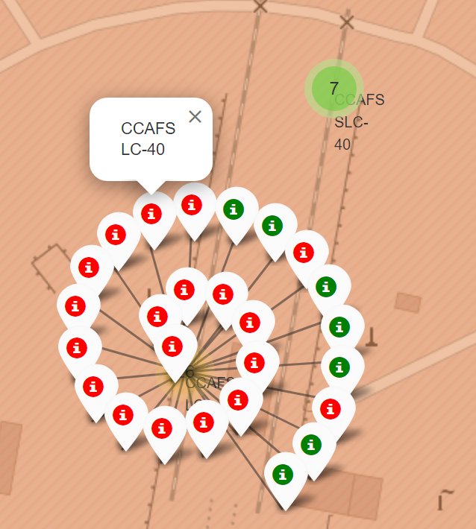
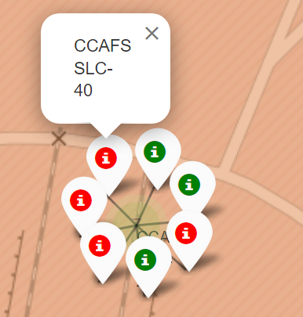
Launch sites with markers of successful launches
The 3 launch sites Florida (KSC LC- 39A, CCAFS LC-40, CCAFS SLC-40) carried majority of launches.
Based on the green markers which indicates the successful launch the KSC LC- 39A has the highest green markers compare to the red markers 10:3.
California
Florida

Slide 37
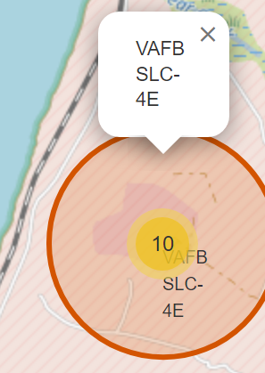
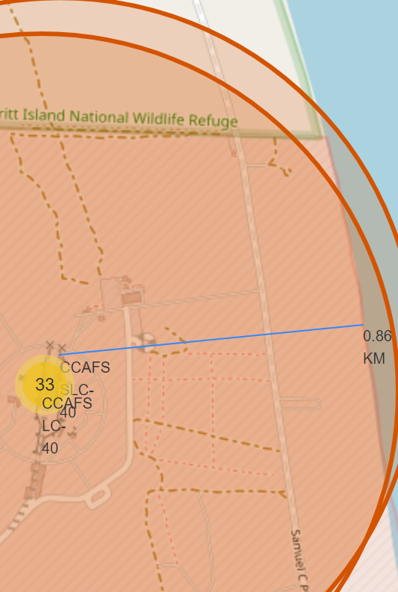
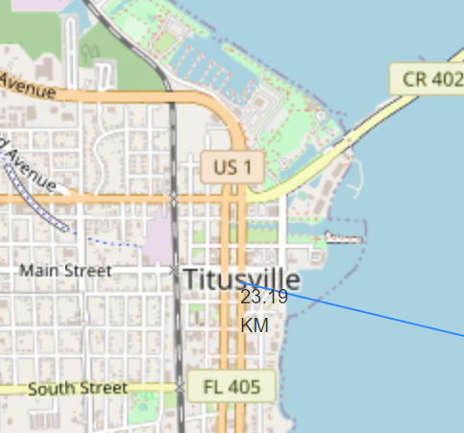
Launch sites with distance to landmarkes
Approximately all the 4 sites to coastline and the closest site is CCAFS SLC-40 with 0.86KM to coastline.
Approximately all sites keep away from cities.
Approximately all sites close to railway and highway.

Slide 38

Section 4

Slide 39
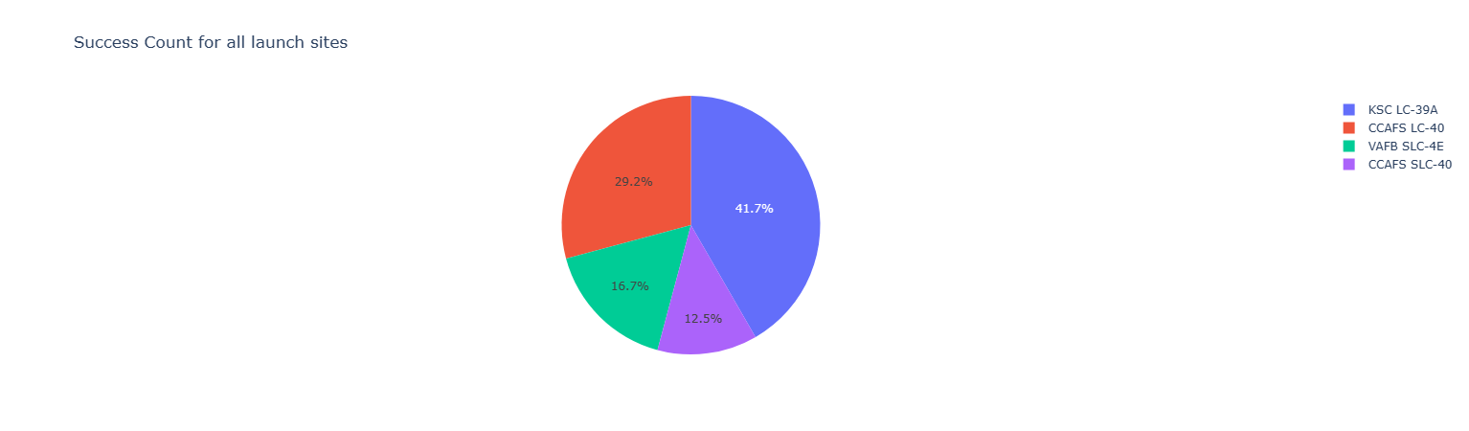
The success percentage for all launch sites
The pie chart shows that 42% of the success launch was on the site (KSC LC- 39A) followed by (CCAFS LC- 40) with 29%.

Slide 40
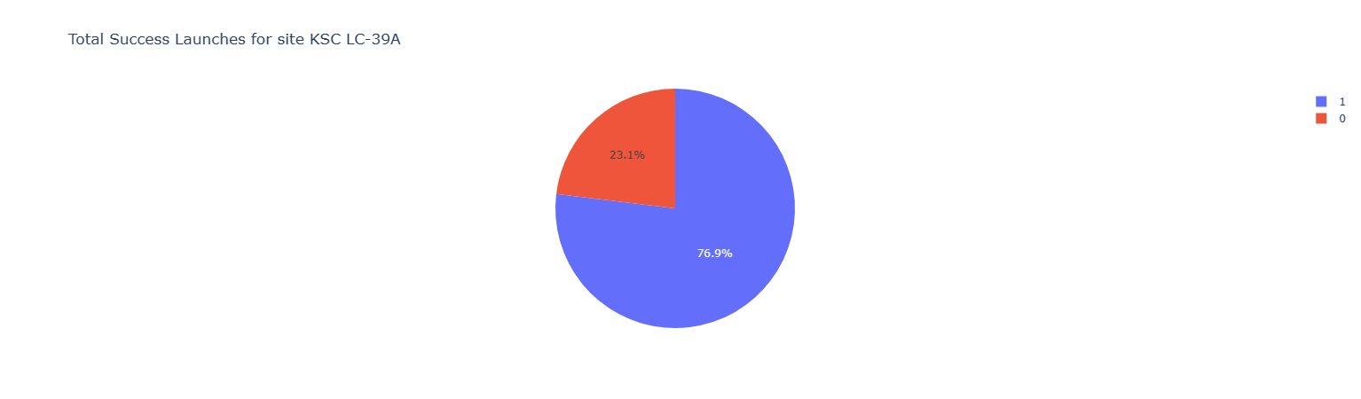
The launch site with the highest launch success rate
In line with previous slide here is the highest total success launch rate which is in the site (KSC LC-39A) with 77% success launches.

Slide 41
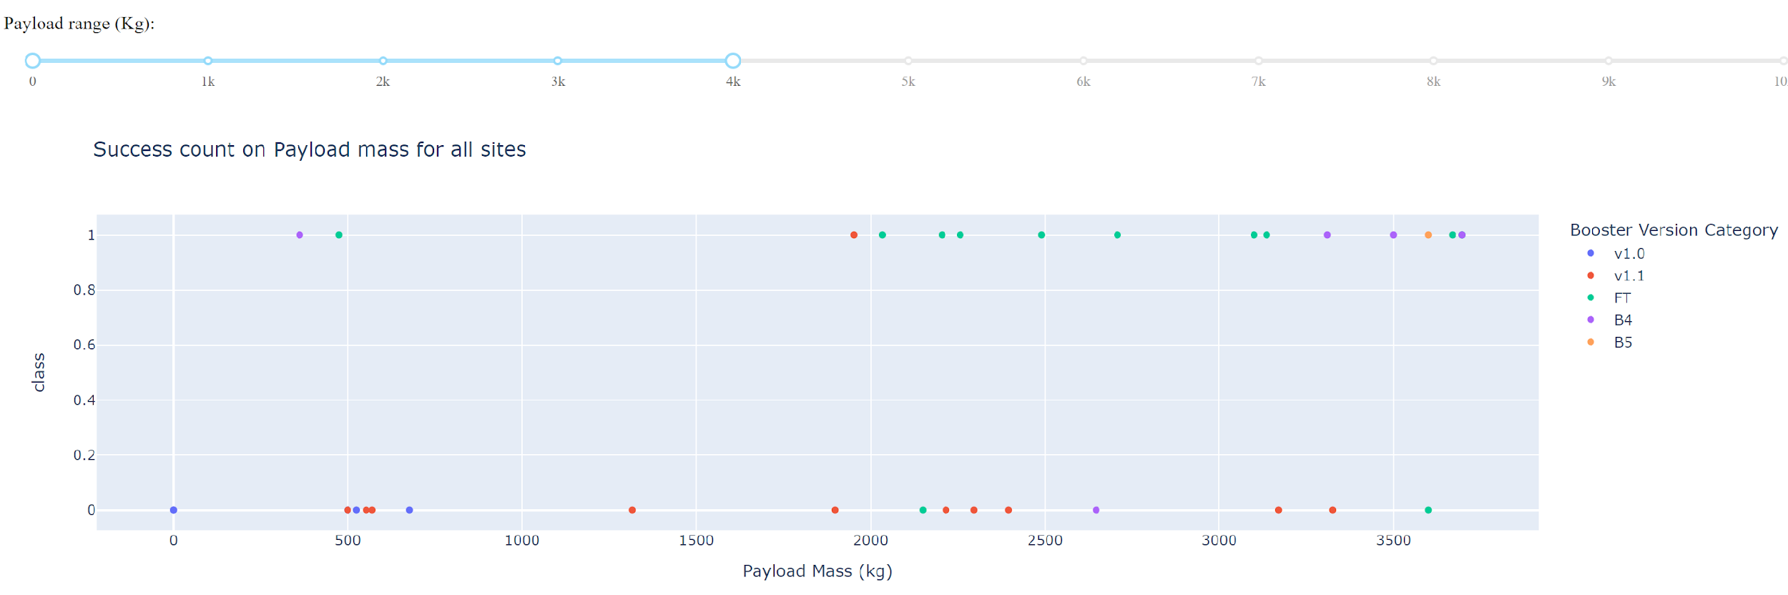
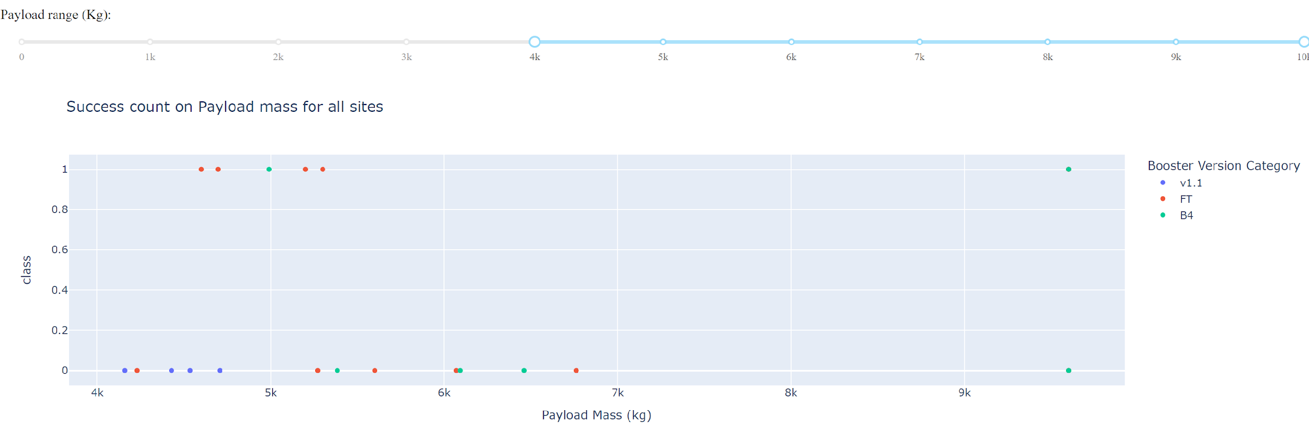
Payload vs Launch outcome for all sites
In the low range of payload range (0-4000kg) with booster version category (v1.0, v1.1, FT, B4, B5).
In the heavy of payload range (4000-10000kg) with booster version category (v1.1, FT, B4).
It is noticed that the FT booster version category has the highest success rate specially in the payload range of 2000-6000kg.
Light range of Payload 0-4000kg
Heavy range of Payload 4000-10000kg

Slide 42

Section 5

Slide 43
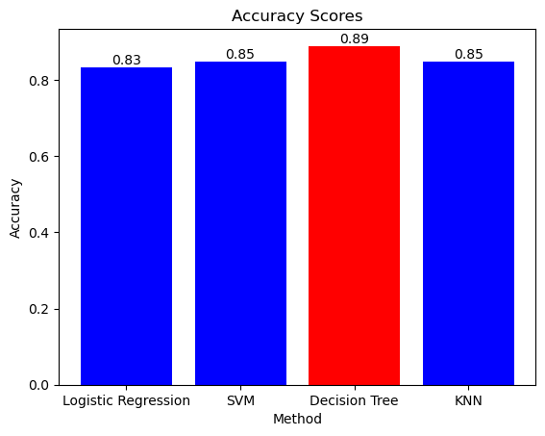
Classification Accuracy
From par-chart, It can see that the Decision Tree model has the highest accuracy rate with 89%.

Slide 44
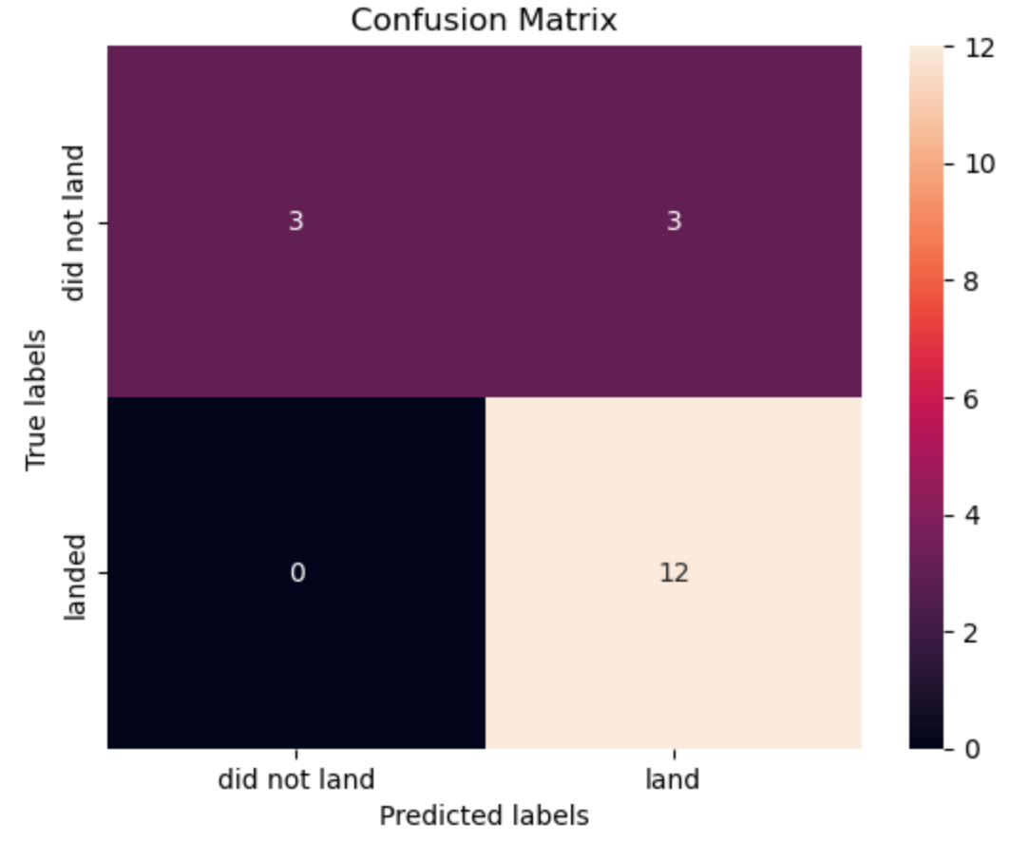
Confusion Matrix of the best model (Decision Tree Model)
The confusion matrix for the Decision Tree model indicates that the model able to predict 12 success lands and 3 unsuccess lands which in line with true landing matrix. Where the model fail to predicate 3 unsuccess landings.

Slide 45
Conclusions
The first 4 orbit types (ES-L1, GEO, HEO, SSO) had the best successful rate.
With heavy payloads the successful landing rate are more for Polar, LEO and ISS.
In 2013 the success rate were gradually increased.
42% of the success launch was on the site (KSC LC- 39A) followed by (CCAFS LC- 40) with 29%.
The highest total success launch rate which is in the site (KSC LC-39A) with 77% success launches.
The FT booster version category has the highest success rate specially in the payload range of 2000-6000kg.
Decision Tree model has the highest accuracy rate with 89%.

Slide 46


